Slide 1
A Presentation on the topic of Hotel Management Website
Presented by :
Archit Bhagowati (210710007008)
Shanan Thakuria(2107100070435)
Saquib Bin Halim(220750007005)

Slide 2
Introduction:
Overview of the project
Key features of the hotel management website

Slide 3
Project structure:
Description of the project directory structure
Filles included:
Index.html
Styles.css
Script.js

Slide 4
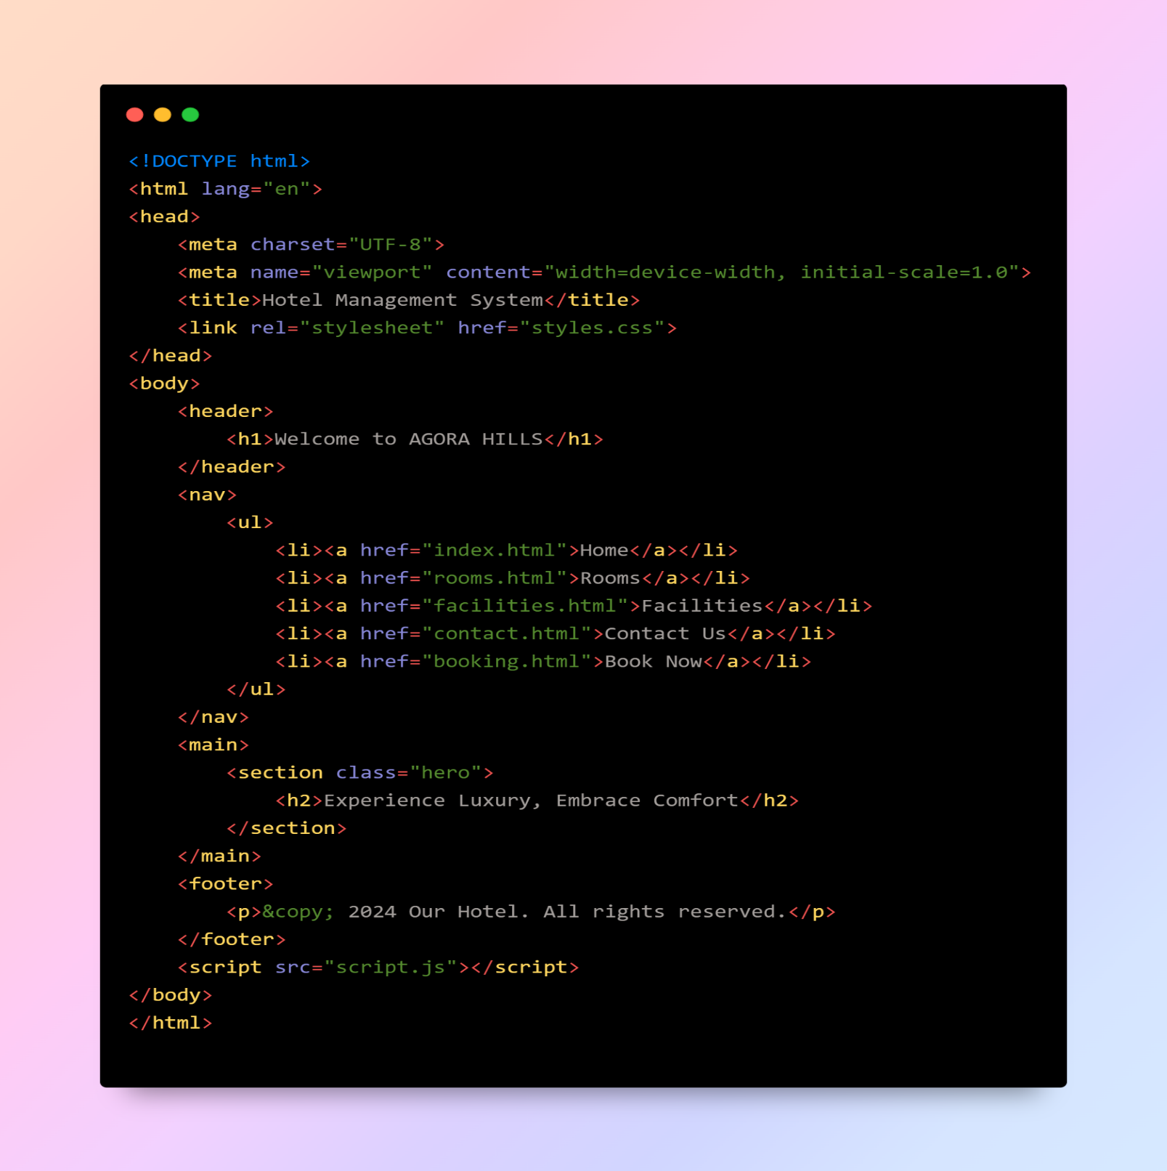
Html structure:
Purpose of index.html
Highlighting the main sections like
1)Header
2)Navigation
3)Main content
4)Footer

Slide 5
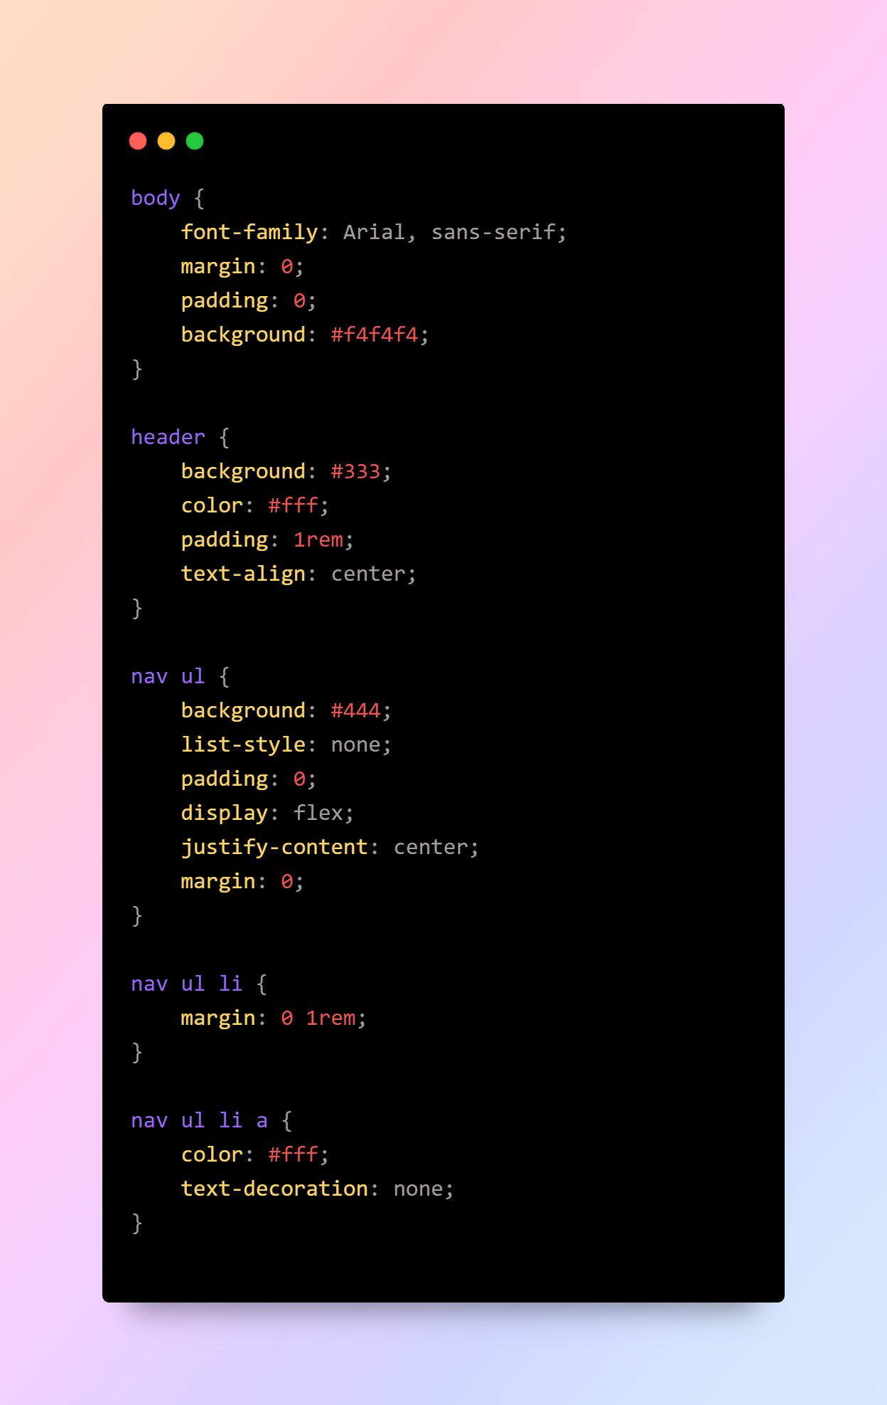
CSS styling:
An overview of the style.css
Key styles included here are:
1)Header
2)Navigation
3)Hero section
4)footer

Slide 6
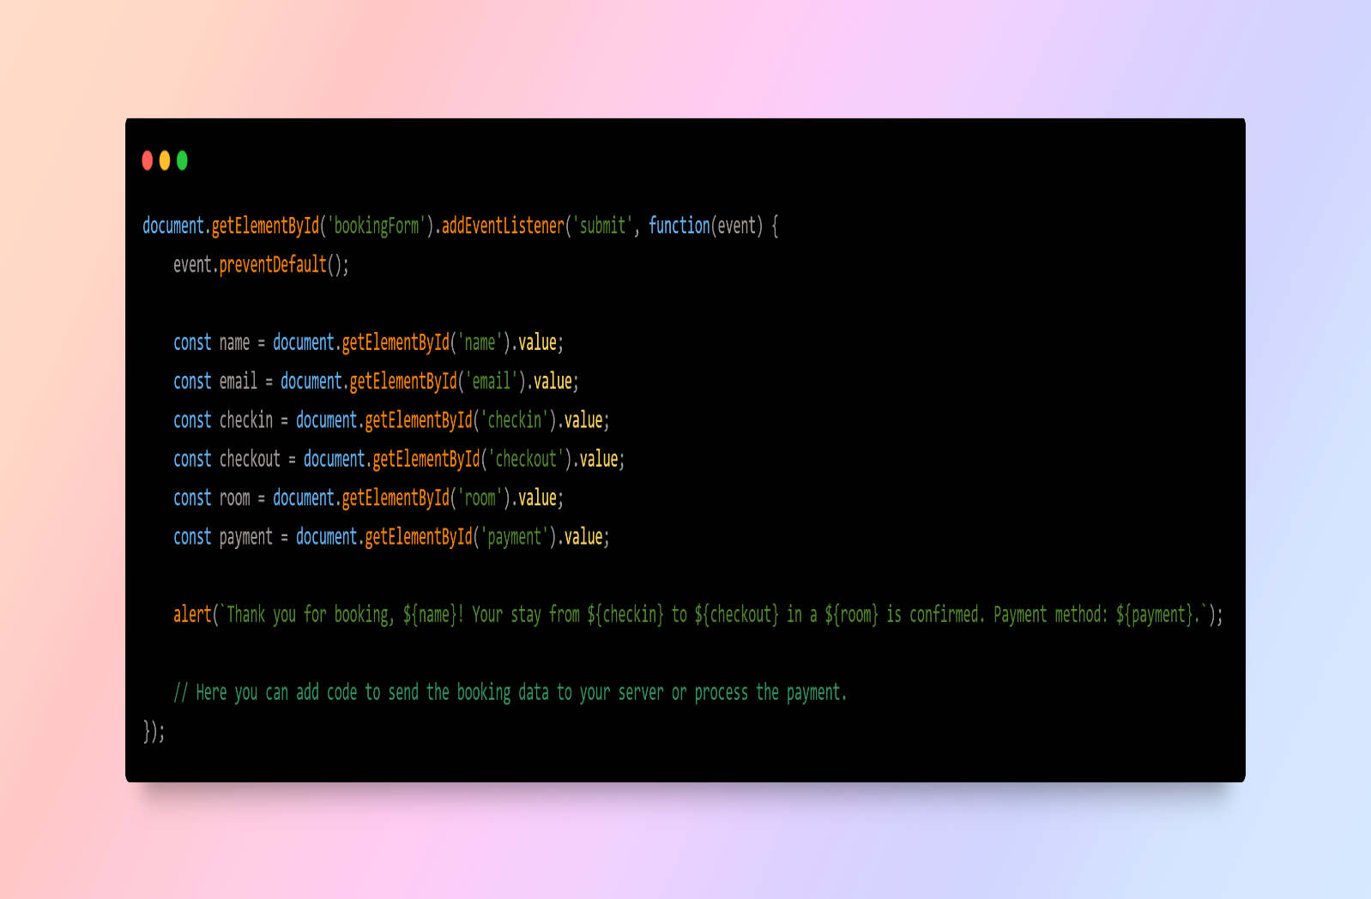
JavaScript Interactivity :
Functionality of script.js

Slide 7
Demonstration :
Live demo of the website

Slide 8
Future Enhancement :
Potential improvements and additional features:
Online booking system integration
Payment processing
User authentication
More detailed pages can be included(rooms,facilities,etc.)

Slide 9
Conclusion :
With the basic knowledge of web development a basic level website can be create with suitable features which can be further improved with necessary tools to make the website much more capable and useful to general users .

Slide 10
Thank You !

